Slide 1
UNIVERSITY ADMISSION
DATABASE SYSTEM
A structured MySQL database for managing student admissions,
programs, qualifications, documents, and enrollment.
BY:NANZIRI SHAMIRAH
2025/BCS/142/PS

Slide 2
PROJECT INTRODUCTION
What is it?
Why this system?
A relational database built in MySQL Workbench to manage the full university admission lifecycle.
It covers:
Student applications
Program enrollment
Academic qualifications
Document tracking
Admission decisions
Universities handle thousands of applicants each year. A structured database ensures:
No data duplication
Fast status tracking
Accurate reporting
Organized record keeping

Slide 3
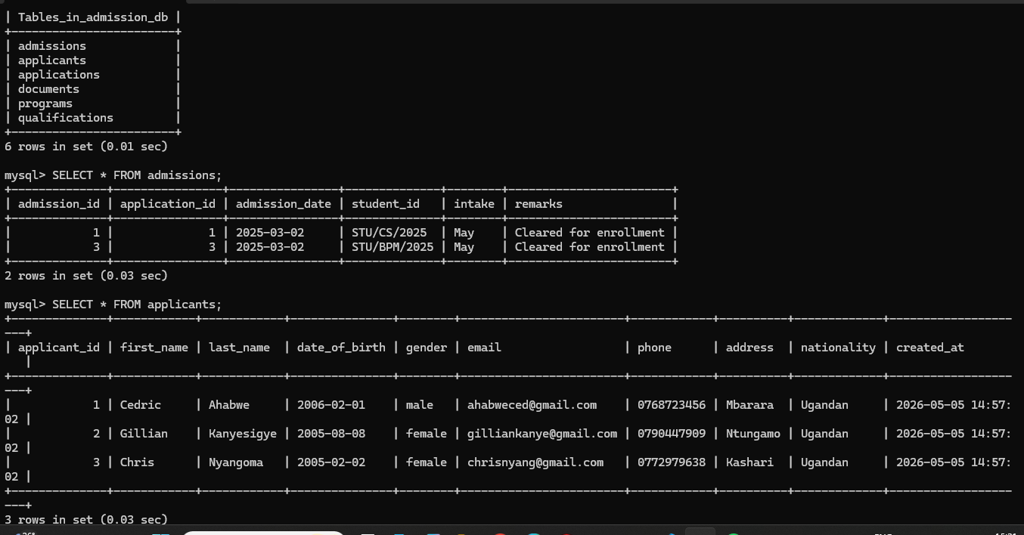
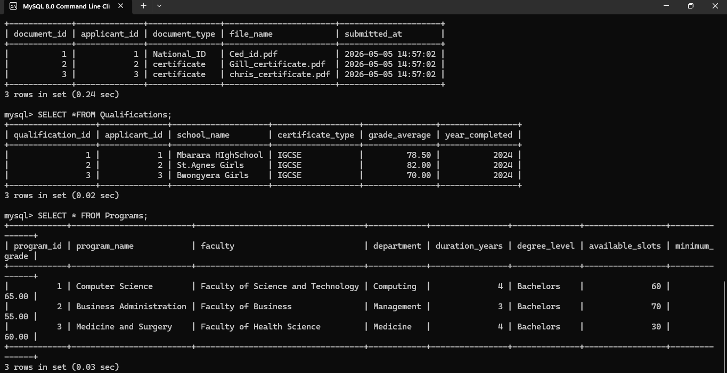
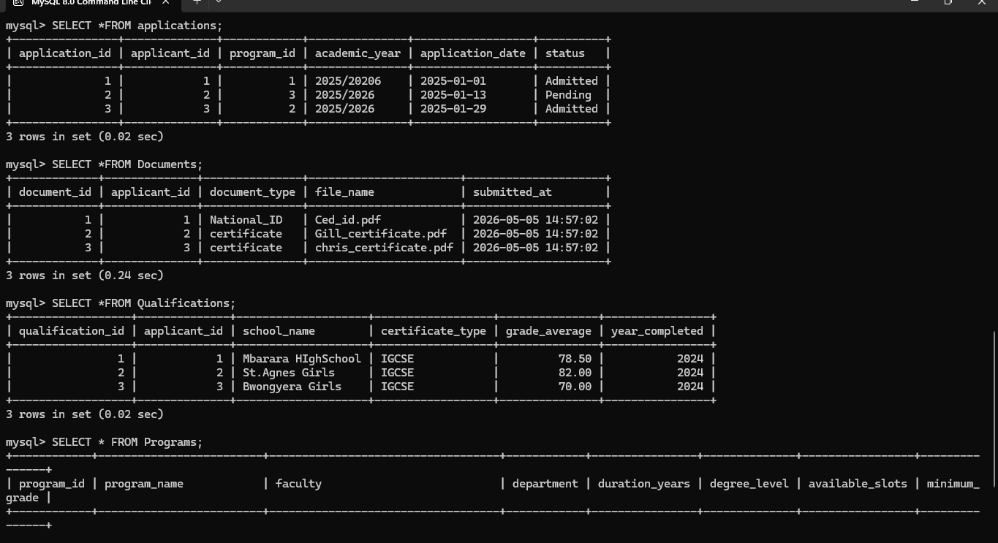
DATABASE TABLES OVERVIEW
6 tables | admissions_db
Programs
Courses, faculty, degree level, slots
Applicants
Personal info, contact, nationality
Documents
IDs, transcripts, certificates
Applications
Links applicant to program + status
Qualifications
School, certificate type, grades
Admissions
Final decision, student ID, intake

Slide 4
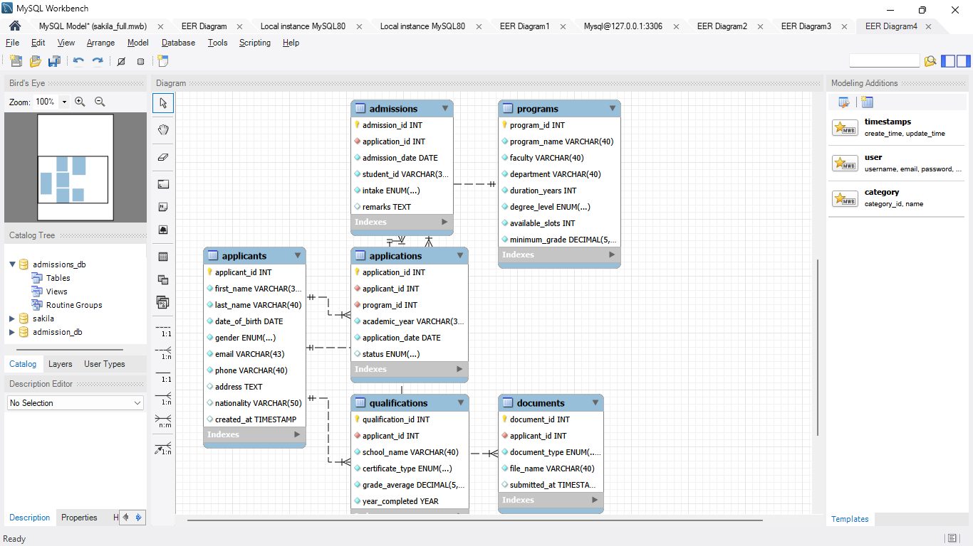
TABLE RELATIONSHIPS

Slide 5
SAMPLE DATA
3
Applicants enrolled
2
Students admitted
3
Programs available

Slide 6
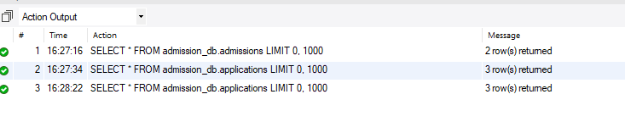
KEY SQL QUERIES
View All Applicants
SELECT * FROM Applicants;

Slide 7
CONCLUSION
Finally, the universitty Admission Database system is a practical,well-structured solution to the challenges of managing university admissions.with six normalized tables,foreign key relationships ,status tracking,and meaningful JOIN Qurries,this system is ready to support a real universityadmission office.
Thank You!

